Slide 1

Evaluating Web Sites
The Internet provides a rich source of information, however
Although it is tempting to think that everything is on the Internet, it is not
There are many Web sites with inaccurate, confusing and misleading information

Slide 2
Evaluating Web Sites Cont’d
Since there is no editor in charge of the Internet it is necessary to evaluate Web sites before using the information on them
Many criteria have been suggested in the literature for the evaluation of the credibility of an Internet source

Slide 3
Evaluating Web Sites Cont’d
However the criteria that this course will adopt are:
Authority
Accuracy
Objectivity
Currency
Coverage

Slide 4
Evaluating Web Sites Cont’d
Authority
Authority is concerned with the credentials of the author of the information
Who has created the Web page content?
Is there any author contact information?
What degrees or experience does the author have?
These questions help to determine whether the author is a reliable source or even an expert in the subject area

Slide 5
Evaluating Web Sites Cont’d
Accuracy
This is concerned with the accuracy of the information contained in the Web site
Can any of the facts be verified against another source?
Are there spelling or grammatical errors (since this helps to indicate whether the author took care in writing the material)?
Is there a person or body responsible for the accuracy of the information (e.g. the Publishers of a Journal do blind peer reviews)?

Slide 6
Evaluating Web Sites Cont’d
Objectivity
This is an attempt to determine whether the information is objective or biased
Does the author have a clear point of view?
Is the site run by Government, a University or a business trying to sell a product?

Slide 7
Evaluating Web Sites Cont’d
Currency
This is concerned with the publication date of the article
On Web sites this is not always clear
Information that is updated regularly is more likely to be useful as references for research papers
Web sites with links that go nowhere (i.e. dead links) often indicate that it has been abandoned or that the information is simply not up to date

Slide 8
Evaluating Web Sites Cont’d
Coverage
This is concerned with whether information about a given topic is covered in-depth
Shorter articles, which are most common on the Internet, tend not to have the depth of information required for research papers
Articles for bibliographies or a list of references provide a valuable source of additional articles that can be used

Slide 9
Evaluating Web Sites Cont’d
Typically, the order of importance of sources are:
Peer-reviewed Journals
Peer-reviewed conference proceedings
.gov, .edu sites (run by the government and Universities)
.org, .com, .net sites (run by individuals or companies)

Slide 10
Attributes of Information Quality

Slide 11
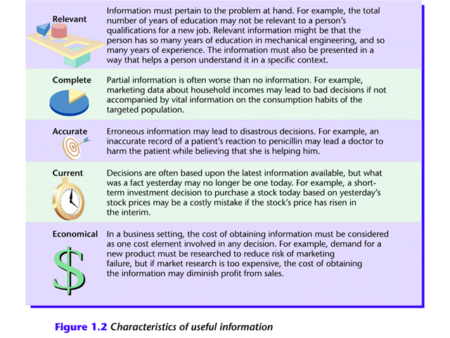

Slide 12
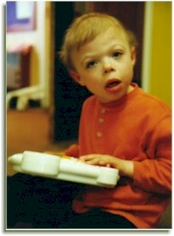
Web Site Usability
“From whence we came”
Early Web sites simply provided information and often did not include e-mail addresses; those who did did not have enough staff to respond to the email

Slide 13
Web Site Usability Cont’d
A visitor should be given access to the:
organisation’s history,
A statement of objectives/mission statement
Information about products or services
A way to communicate with the organisation
Every visitor to a Web site is a potential customer
It is difficult to meet all the needs of visitors

Slide 14
Web Site Usability Cont’d
Some of the motivations of visitors include:
Learning about products and services
Buying products or services
Obtaining general company information
Identification of the management team and their contact information
Obtaining company financial information in order to make investment decisions

Slide 15
Web Site Usability Cont’d
Meeting Visitors Needs
To meet the needs of Web site visitors you must consider:
The expectation level and experience when they enter your site
The communication channel used to connect and the bandwidth
The web browser used
The add-ins available for the browser being used

Slide 16
Web Site Usability Cont’d
Build Flexible Web sites
Separate version with and without frames
Text-only versions (for visually impaired people who use special browser software)
Get user the option to download smaller versions of graphics
If audio or video clips included, give user the option to select the connection type (so that adjustments may be made for bandwidth)

Slide 17
Web Site Usability Cont’d
Build Flexible Web sites Cont’d
Let users select the level of detail, viewing format and download format
Offer visitors multiple information formats (e.g. HTML, PDF or Excel spreadsheet for financial data)

Slide 18
Web Site Usability Cont’d
Macromedia Flash
There has been some controversy surrounding the use of Macromedia Flash:
The files (which are not rendered in HTML) take a long time to download, especially if you do not have a broadband connection- Continuous improvements made
Few major e-commerce sites use these type of animated graphics pages

Slide 19
Web Site Usability Cont’d
Macromedia Flash Cont’d
Some tasks however do lend themselves to animation
One solution is to offer Flash or non-Flash pages

Slide 20
Web Site Usability Cont’d
Web Site Design Goals
A Web site developer should try to meet the following goals:
Provide easily accessible organisational information
Provide a two-way communication link with the organisation
Encourage return visitors (e.g. announce upcoming content) and keep the attention of existing visitors
Provide full access to products and services

Slide 21
Web Site Usability Cont’d
Customer Trust and Loyalty
Customer trust/loyalty translates to return visits
A customer that purchases a product from a business and gets good service will begin to trust the business. Multiple good experiences leads to loyalty
A 5% increase in customer loyalty can yield 25-80% profit

Slide 22
Web Site Usability Cont’d
Customer Trust and Loyalty
Customer service on E-commerce sites
Research indicates a rating between average to low
There is often a lack of integration between the call centres and the Web site
E-mail responsiveness is also an issue (slow or no replies to emails)

Slide 23
Web Site Usability Cont’d
Usability Testing
Companies are only now performing usability testing on their Web sites
Average e-commerce sites frustrate up to 70% of their users (resulting in the user leaving the site without purchasing anything)
Sites are confusing or difficult to use
In many cases simple changes can improve the usability of the site
(See http://www.cs.umd.edu/hcil/ and http://www.useit.com/alertbox/ for further details)

Slide 24
Web Site Usability Cont’d
Customer-centric Web Design
The following guidelines serve to meet the needs of the customer (as opposed to any Web site visitor):
Arrange links in the way that a customer would use them
It should be possible to access information quickly
Keep product and service descriptions simple, do not over sell by including a lot of marketing
Keep the language simple and jargon free

Slide 25
Web Site Usability Cont’d
Customer-centric Web Design Cont’d
The Web site should work with the oldest browser, running on the oldest computer at the lowest bandwidth
This might mean several different versions of the Web site are required (what about the cost of updating content?)
Label all navigational aids clearly
Test text visibility on smaller monitors

Slide 26
Web Site Usability Cont’d
Customer-centric Web Design Cont’d
Choose colour combinations that would not impair the vision of colour-blind visitors
Test the usability of your site using potential users
Always ensure that enough information has been provided for the customer otherwise they will go elsewhere.

Slide 27
Web Site Usability Cont’d
Web site Response Times The required response time for hypertext navigation is one second, therefore your Web pages should be no more than 3KB (assuming a 28.8kbps modem which most users have).
The above limitation rules out most graphics

Slide 28
Web Site Usability Cont’d
Three Important Response Times
The basic advice on response times are:
0.1 seconds for a user to feel that a system is instantaneous
1.0 seconds for the user’s thought to remain uninterrupted
10 seconds for keeping a users attention
Generally, the response time should be as fast as possible

Slide 29
Web Site Usability Cont’d
Continuous Feedback
When an immediate response is not possible continuous feedback should be provided
a percentage completed indicator?,
if the operation takes more than 10 seconds, which has three advantages:
It assure the user that the system has not crashed
It indicates how long the user has to wait
It provides the user with something to look at, which makes the wait less painful (for this reason a graphic progress bar is far better than text)

Slide 30
Web Site Usability Cont’d
Continuous Feedback Cont’d
When the amount of work to be done by an operation is unknown a percentage completed indicator might be inappropriate
In this case a number of progress indicators are still available:
If an operation goes through a defined set of steps, these steps could be displayed as they are started and completed
As a last resort progress indicator, such as dots printed on a status line or a spinning ball could be used – which indicates that the system is working

Slide 31
Web Site Usability Cont’d
Continuous Feedback Cont’d
For operations that complete within 2 – 10 seconds a percentage done indicator is unnecessary

Slide 32
Design of Evaluation Experiments
Design of experiments
http://en.wikipedia.org/wiki/Design_of_Experiments
http://pages.cpsc.ucalgary.ca/~sheelagh/courses/481/4bPsych/psychopathology.pp

Slide 33

Psychology of Everyday Things
Psychology of Everyday Things, Norman, D. A. (1988) The Design of Everyday Things,

Slide 34
User Interface Evaluation
The purposes of evaluation
Goals of evaluation
What, why and when to evaluate
Evaluation framework
Evaluation methods

Slide 35
Usability
Important Dimensions of Usability:
Effectiveness , Efficiency, Satisfaction
Users want systems that are easy to learn and use as well as effective, efficient, safe and satisfying
Notes:
Effective—The completeness and accuracy with which users achieve their goals.
Efficient—The speed (with accuracy) with which this work can be done.

Slide 36
Evaluation vs Testing
Testing:
Ensure features operational
Implemented after the system is developed
Evaluation (Usability Testing):
Ensure features usable
Simply experiments to find out specific information about a design
User centred
Considered at all stages in the design life cycle

Slide 37
What to Evaluate?
Features:
Sequence of interactions needed to be followed to play a game, task in a simulation
Usability principles:
Learnability, flexibility, and robustness
Performance:
Measure the performance of typical users on typical tasks

Slide 38
What to Evaluate? (measurements)
Measurements can be user related, e.g. -
Attitude, user satisfaction (positive or negative)
Knowledge, recall (what has been learned)
Goal related (aim to achieve a task, effectiveness)
Usability criteria based (is the system usable)
Error rates

Slide 39
When to Evaluate?
Formative evaluation:
Evaluation that done during the design phase
To check that the product continues to meet user’s needs
helps to ‘form’ the finished information system.
Contextual Inquiry
Co-operative evaluation
http://www.cs.bgsu.edu/maner/domains/Formeval.htm
Summative evaluation:
Evaluations that are done to assess the success of a finished product
Produces quantitative and qualitative data about the finished system.

Slide 40
Formative Evaluation
QUESTIONS ANSWERABLE DURING FORMATIVE EVALUATION
Are parts of the interface error-prone?
Do some tasks take more time than expected?
Do users find some tasks especially difficult?
Does the interface violate common usability guidelines?
Is there sufficient help?
What changes would users like to see?
What mistakes do users make?
Where are users likely to get stuck?
Will users need a wizard (intelligent agent) to guide them through certain complex tasks?

Slide 41
Evaluation Framework
1. Issues to be measured
2. Usability Testing Methods to
collect data
3. Testing episode
4. Results analysis
5. Report

Slide 42
Evaluation Methods
Interviews
Questionnaires
Feature checklist
Focus groups
Usability Laboratories
Heuristic Evaluation
Cognitive Walkthrough

Slide 43
Evaluation Methods (Feature checklist)
Quantitative
Examines features used
- Usage, knowledge required, need

Slide 44
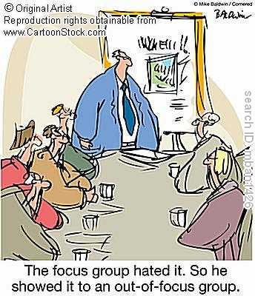
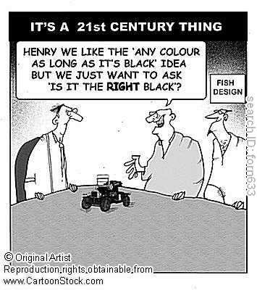
Focus Groups

Slide 45
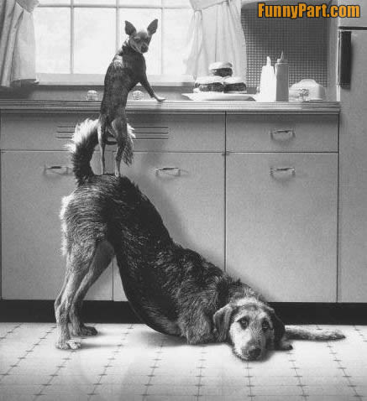

Focus Groups
Many Heads are Better than one
Team Work

Slide 46
Evaluation Methods (Focus Groups)
Qualitative method
Organised as a group discussion
Works on the concept of human triggers (someone says something, others pick up)
Good for : interface options, what’s good / bad, and suggesting improvements
Choose users who fit the user profile
Good for general ideas or brainstorming etc

Slide 47
Evaluation Methods (Interviews)
Structured interviews expect the user to select a response from a given set of responses
Unstructured interviews: asked a series of open-ended questions
Guidelines for developing questions:
Avoid long questions
Avoid using jargon and language that the interviewee may not understand
Be alert to unconscious biases

Slide 48
Evaluation Methods (Questionaires)
Advantage:
It can be distributed to a large number of people
Provide evidence of wide general opinion
Easy and quick to conduct
Q’s are a good source of subjective responses i.e. a measure of user attitude
Less reliable when it comes to collecting objective data
Vast amounts of data which then need to analysed
Producing a good Q is time consuming and a skilled practice

Slide 49
Evaluation Methods (Heuristic Evaluation)
Focus on rogue design features
Jacobs Framework/Guidelines
http://www.useit.com/papers/heuristic/heuristic_list.html
http://www.useit.com/papers/heuristic/heuristic_evaluation.html

Slide 50
Evaluation Methods (Heuristic Evaluation)
An informal usability inspection technique developed by Jakob Nielsen and his colleagues
Visibility of system status
“Where am I?”, “where can I go next?”
Keep users informed what’s going on

Slide 51
Evaluation Methods (Heuristic Evaluation)
Match between system and the real world
The system should speak the user’s language which are familiar to the user

Slide 52
Evaluation Methods (Heuristic Evaluation)
User Control and Freedom
Users often choose system function by mistake
A clearly marked emergency exit or termination an operation (Assembling operation in an immersive simulation, home button on a web portal)

Slide 53
Evaluation Methods (Heuristic Evaluation)
Consistency and standards
Users should not have to wonder whether different symbols, words, situations, or actions mean the same thing
Error prevention
Alerting the user with appropriate feedbck. E.g Provide user friendly messages in natural language, beeps, status changes

Slide 54
Evaluation Methods (Heuristic Evaluation)
Recognition rather than recall
Make sure objects, actions and options are highly visible
Flexibility and ease of use
Speed up the interaction for expert user

Slide 55
Evaluation Methods (Heuristic Evaluation)
Aesthetic and minimalist design
Extraneous information on the interfacee is a distraction. Eg. 3D floating menus vs
Help users recognize, diagnose, and recover from errors
E.g Error messages should be expressed in plain language with no codes or jargon

Slide 56
Evaluation Methods (Cognitive Walkthrough)
Evaluates design on HOW EASY user in learning the task
Usually performed by expert in cognitive psychology
Expert `walks though' design to identify potential problems using psychological principles
Can use users, developers, experts walk through scenario in user role
record actions without discussion, then discuss
promotes understanding of user role

Slide 57
Cognitive walkthrough
Cognitive walkthrough is a review technique where expert evaluators construct task scenarios from a specification or early prototype and then role play the part of a user working with that interface--"walking through" the interface.
They act as if the interface was actually built and they (in the role of a typical user) was working through the tasks.
Each step the user would take is scrutinized: impasses where the interface blocks the "user" from completing the task indicate that the interface is missing something.
Convoluted, circuitous paths through function sequences indicate that the interface needs a new function that simplifies the task and collapses the function sequence.

Slide 58
Evaluation Methods (Cognitive Walkthrough)
Expert determines the task, the context, and salient user characteristics
Example:
First year student is asked to carryout the first online Quiz and submit the resuts.
Evaluator then 'walks through' the actions necessary, attempting to predict user behavior and any problems and strategies used to solve the problem.

Slide 59
Evaluation Methods (Cognitive Walkthrough)
Finds out where people get stuck
Finds out which parts annoy / excite the user
Finds out how the system is used

Slide 60
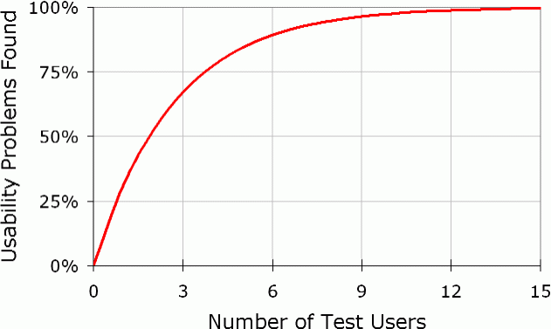
How many users?
Evaluation Methods (Cognitive Walkthrough)
Maximum of 5 users -
http://www.useit.com/alertbox/

Slide 61
Evaluation Methods (Samples of Questions asked in Cognitive Walkthrough)
Will users be able to notice that the correct action is available?
Once the users find the correct action on the interface, will they know that it is right one for the effect they are trying to produce?
After the action is taken, will users understand the feedback they get?

Slide 62
Evaluation Methods (Samples of Questions asked in Cognitive Walkthrough)
For each task walkthrough considers
What impact will interaction have on user?
what learning problems may occur?
Does the design lead the user to generate the correct goals?

Slide 63
Observation (some metrics)
Time to complete task.
Percentage of task completed.
Tasks completed per unit time (speed metric).
Ratio of successes to failures.
Time spent in errors.
Percentage number of errors.
Number of commands used.
Frequency of help use.
Time spent using help
Percentage of favourable/unfavourable user comments.
Number of repetitions of failed commands.
Number of runs of successes and of failures.
Number of good and bad features recalled by users.
Number of available commands not invoked.
Number of times users need to work around a problem.
Number of times the user is disrupted from a work task.
Number of times the user loses control of the system.
Number of times the user expresses frustration or satisfaction.

Slide 64

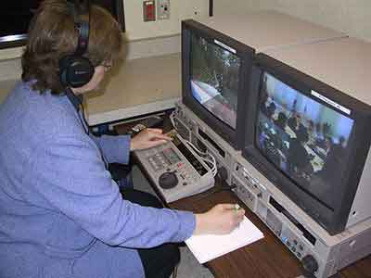
Usability labs
Tour of 32 usability lab tours
http://www.noldus.com/labs

Slide 65
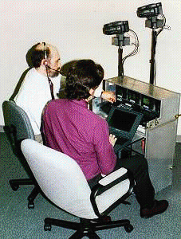
Multi-purpose Rooms
Use available space as laboratory-for-a-day
Bring in portable equipment
Convert an empty office into a full-time lab
Use a lab for other things to help justify cost

Slide 66
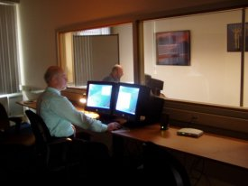
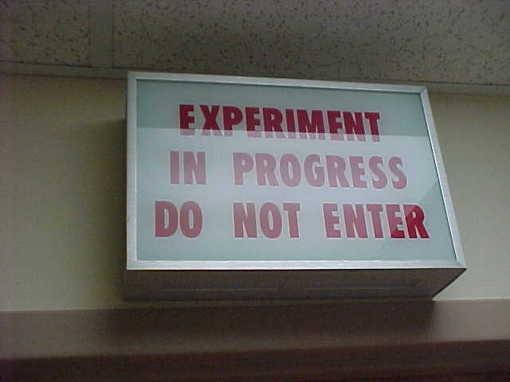
Usability Labs

Slide 67
Full Usability Labs
Build rooms just for this purpose
Adjoining, sound-proofed rooms
Video cameras, scan converters, two-way mirrors, microphones, etc
Cost: USD 200k

Slide 68
Full Usability Labs

Slide 69
Aims of usability labs
Represent real users performing typical tasks in a typical environment
Allow prediction of real-world usability
Allow developers to observe usability problems first hand
Aid in formative feedback for interface design
A lab test can be designed to :
Select from competing products, systems or design prototypes
(Summative & Metrics based)
Diagnose problems, using a Formative approach, (Typically co-operative evaluation, think aloud, etc., aimed at re-design)
Verify acceptance goals, Measures performance against acceptance criteria

Slide 70
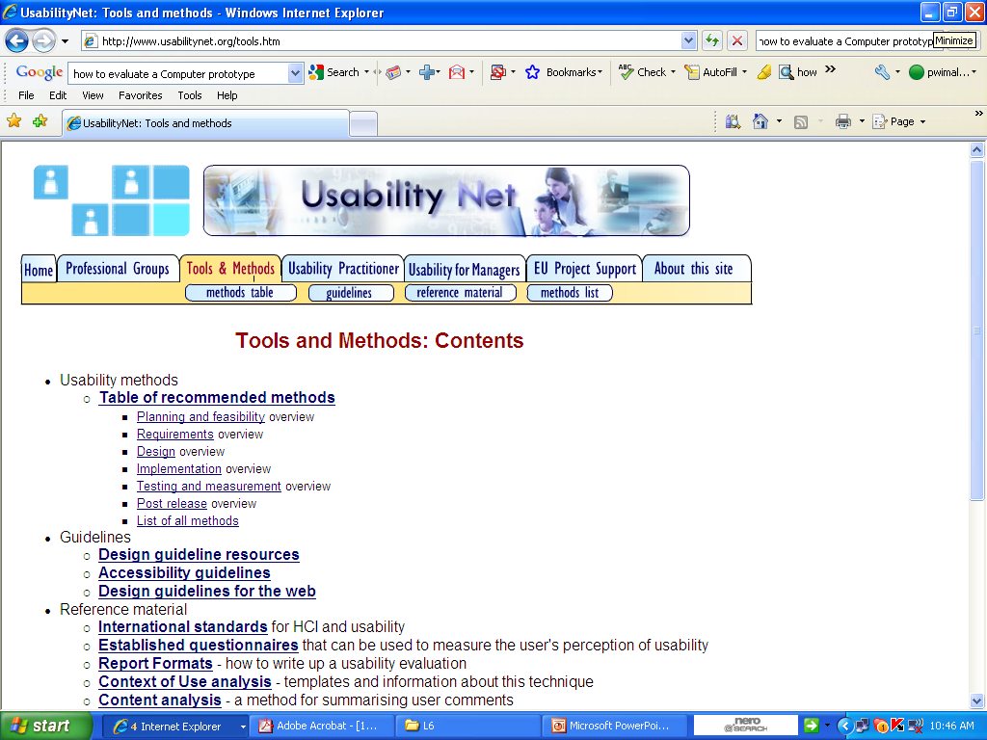
http://www.usabilitynet.org/tools.htm

